Slide 3
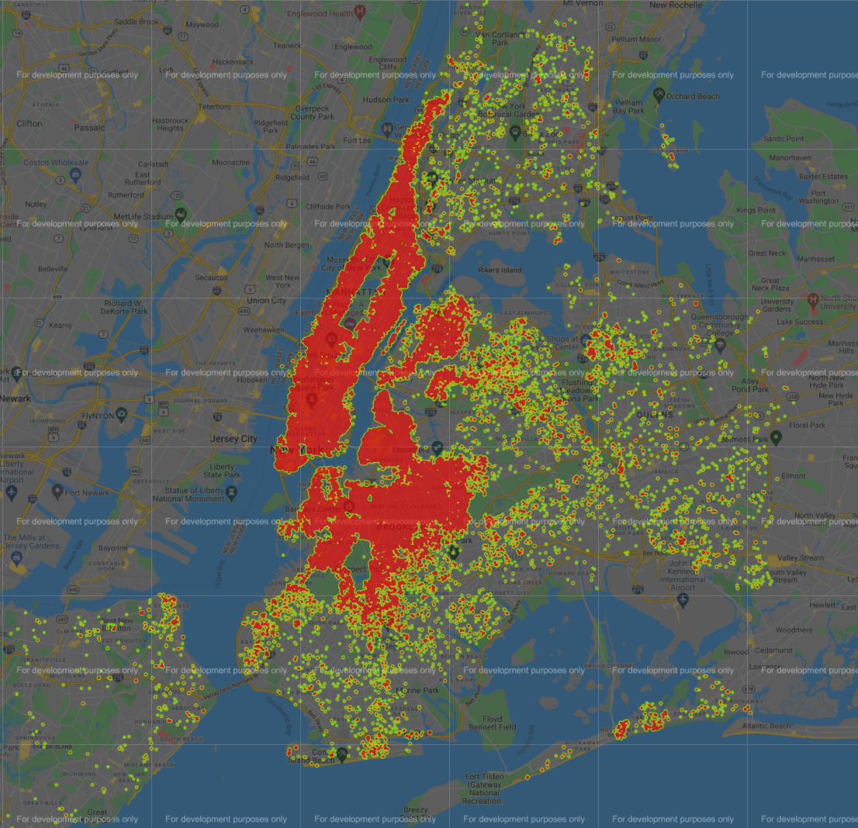
Prices by Borough
Text here

Slide 4
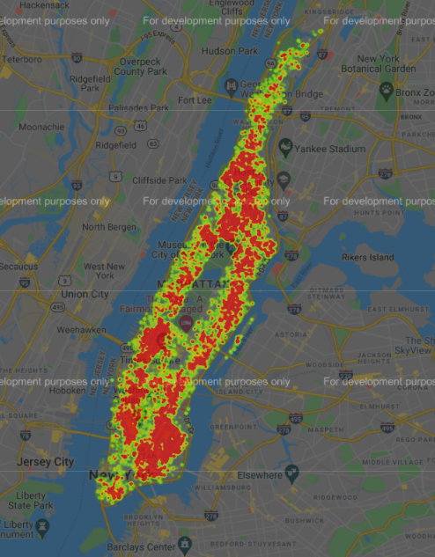
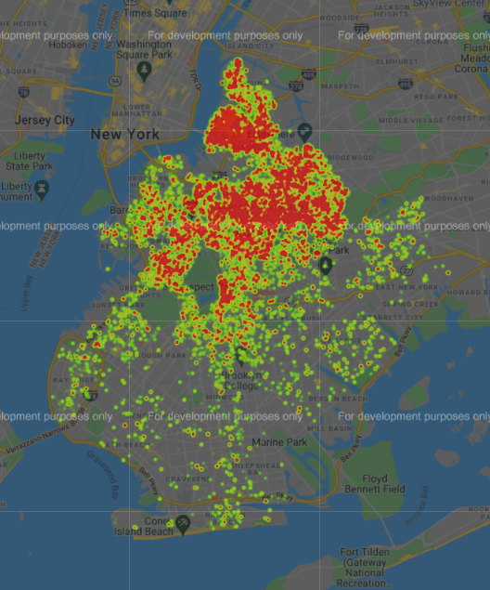
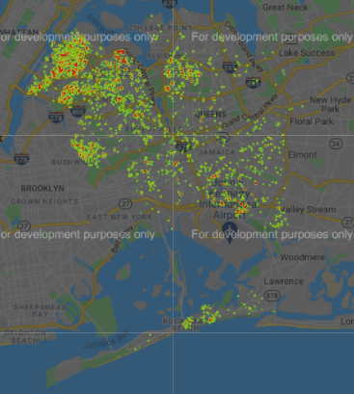
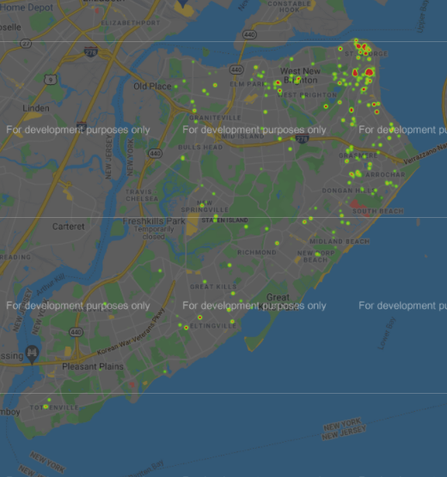
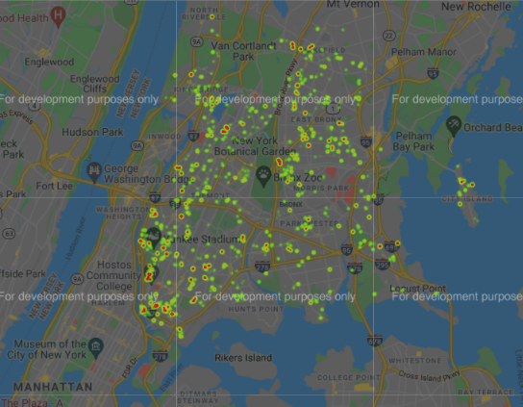
Number of Reviews by Borough
Text here
Manhattan
Brooklyn
Queens
the Bronx
Staten Island

Slide 5
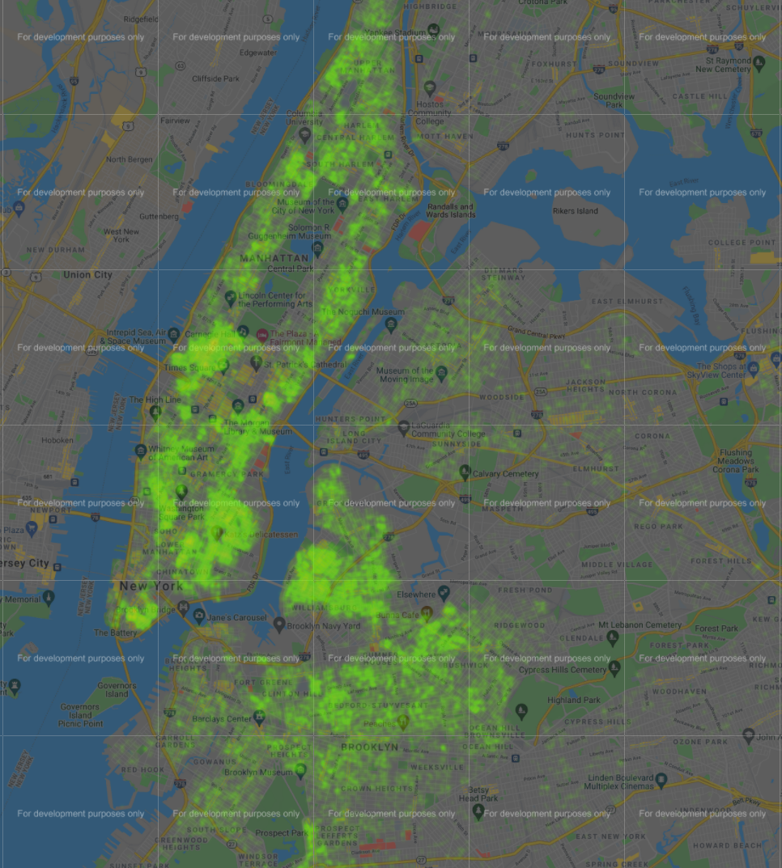
Subway Stations

Slide 6
Two sample T-test: the mean income of Manhattan and Brooklyn

